Slide 1
FIT3143 · APPLIED #1 · GROUP 07
Task 2 — Architecture Design
Distributed EV Charging Navigation System — hybrid MPI/OpenMP, Applied Week 5 APIs only
Point-to-point operational protocol; MPI_Bcast and MPI_Barrier only for setup/sync; OpenMP inside each base
Presented by Jiaqi
Notes:
This section covers Task 2: the final architecture is hybrid MPI/OpenMP. Charging nodes are single-threaded MPI ranks; each base rank additionally uses four OpenMP threads to search its regional cache, under MPI_THREAD_FUNNELED so only the master thread touches MPI. The operational protocol is point-to-point — MPI_Bcast and MPI_Barrier are used only for startup configuration and end-of-round synchronisation. I will walk through the rank layout, both required diagrams, the message catalogue, the correctness rules, and the API-compliance boundary.

Slide 2
TASK 2 · ARCHITECTURE DESIGN
One MPI rank per station, hybrid MPI/OpenMP
The logical topology is preserved without any MPI helper API beyond Applied Week 5.
Hybrid MPI/OpenMP — node ranks are single-threaded; each base uses 4 OpenMP threads for local candidate search (MPI_THREAD_FUNNELED). All operational traffic is point-to-point — only CONFIG_BCAST and ROUND_SYNC use the two collectives shown. No MPI_Cart_create, Comm_split, Allgatherv or MINLOC — replaced by rank arithmetic and a two-phase p2p exchange.
Plane | Participants | Logical topology | Purpose
Local sensing | node ↔ node | non-periodic 2-D mesh via rank arithmetic | Confirm source + all valid neighbours are heavily utilised
Regional reporting | node ↔ assigned base | forest of regional stars | Send status/alerts to the base owning the source region
Global control | base ↔ base | complete overlay, MPI_COMM_WORLD p2p | Share alerts, select globally closest available candidate
The logical topology does not depend on the MPI helper APIs used to build it — rank arithmetic gives the same neighbour relationships as MPI_Cart_shift.
2
Notes:
Same three-plane topology as Task 1, but every plane is now built from operations taught explicitly in Applied Week 5, and each base additionally runs OpenMP internally for its own candidate search. This is a deliberate scope decision: it keeps the report and Q&A defensible against 'why did you use an API we were never taught', while still using shared-memory parallelism where it actually helps.

Slide 3
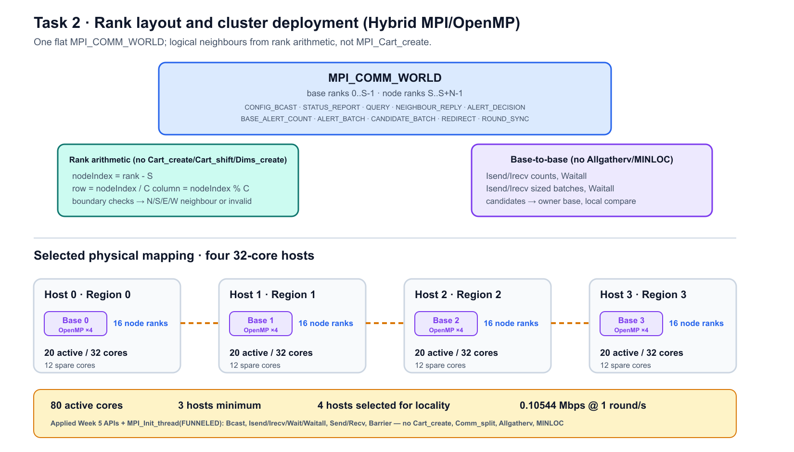
TASK 2 · ARCHITECTURE DESIGN
Rank layout and cluster deployment
One flat MPI_COMM_WORLD; four hosts align with four regions.
3
Notes:
Base ranks are 0..S-1, node ranks are S..S+N-1 — no MPI_Comm_split, no sub-communicators. A node's logical neighbours come from nodeIndex = rank - S, then row/column division and boundary checks — mathematically identical to what MPI_Cart_shift would return, just computed directly. Physically: four 32-core hosts, one per region, 20 active cores each (16 single-threaded node ranks + 1 base rank with 4 OpenMP threads) against a packed minimum of 3 hosts — chosen to keep node-to-base traffic inside a host.

Slide 4
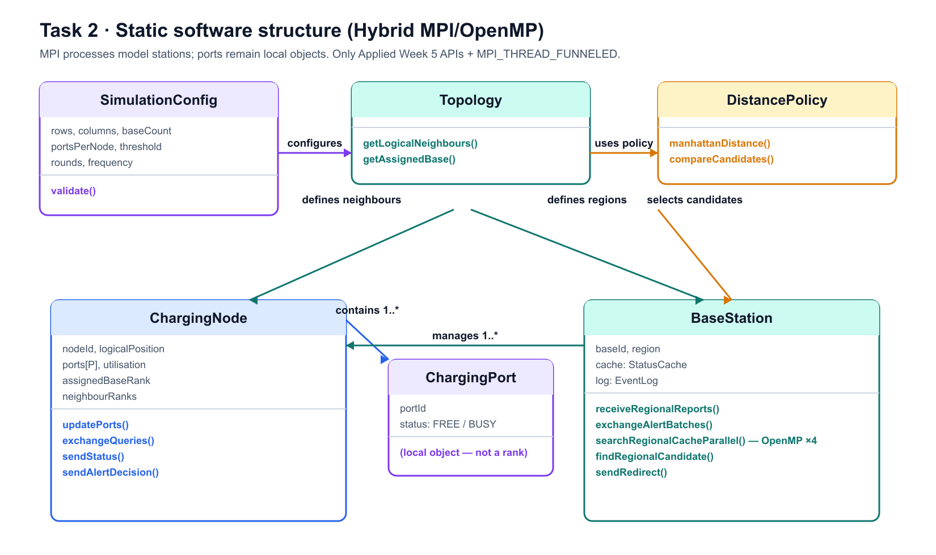
TASK 2 · REQUIRED DIAGRAM 1 OF 2
Static software structure
Charging ports stay local state — not a rank of their own.
4
Notes:
ChargingNode owns ports[P] locally; modelling each port as its own MPI rank would inflate the process count from N+S to roughly NP+S with no useful distributed communication. Topology.getLogicalNeighbours() is rank arithmetic, not a Cartesian communicator query. BaseStation.searchRegionalCacheParallel() is the OpenMP step — four threads scan disjoint parts of the regional cache before findRegionalCandidate() merges the result. DistancePolicy is the deterministic tie-break every base applies locally when comparing candidate vectors received from other bases.

Slide 5
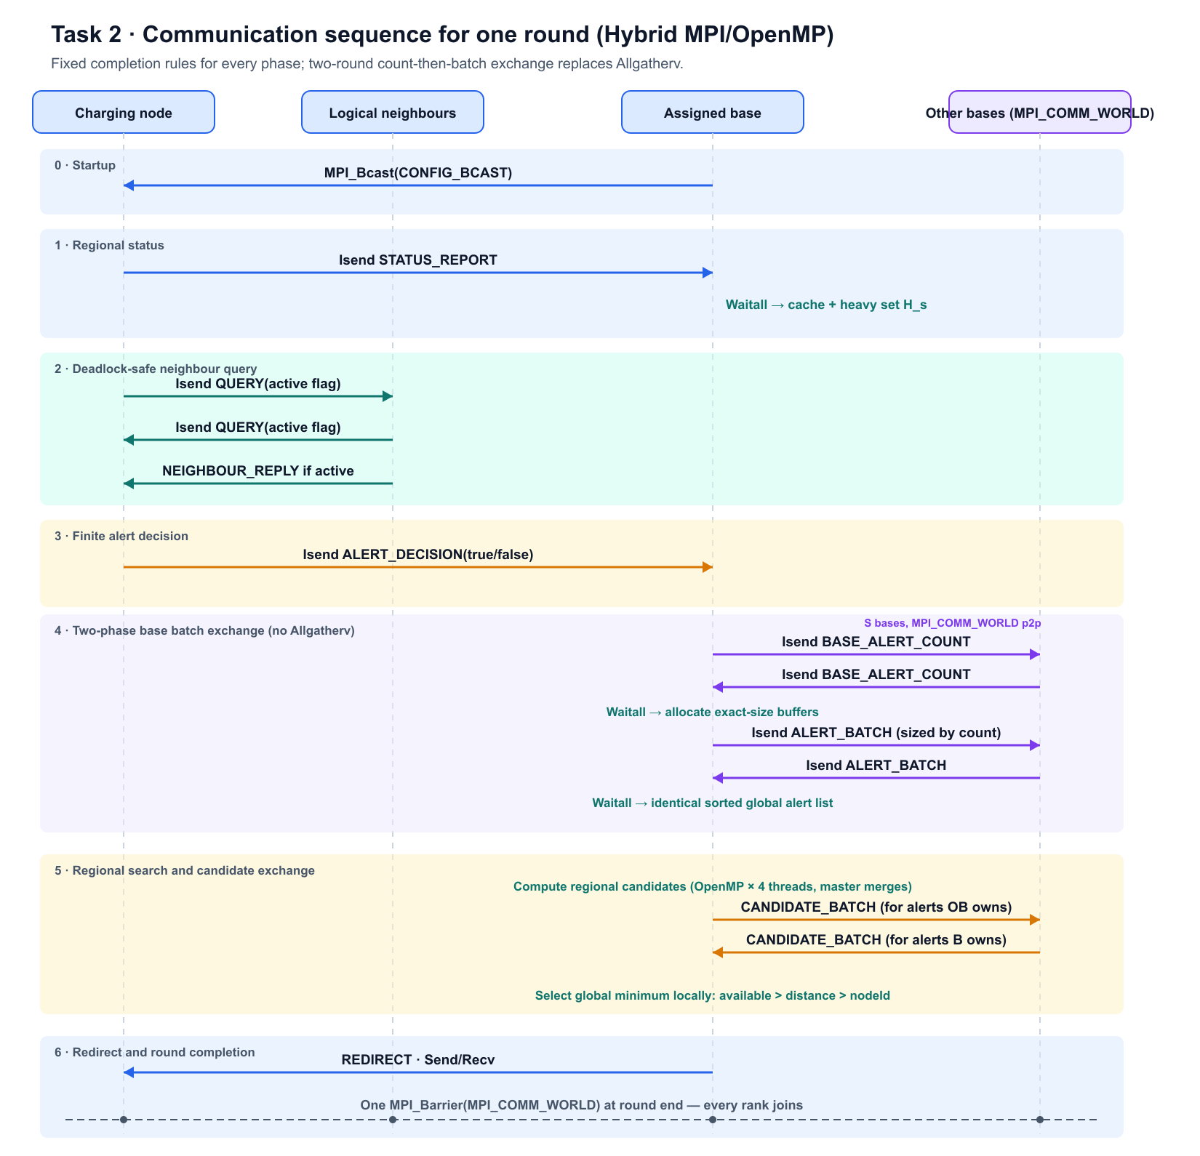
TASK 2 · REQUIRED DIAGRAM 2 OF 2
Communication sequence for one round
Fixed completion rules for nodes; a two-phase count-then-batch exchange for bases.
5
Notes:
Six phases. Phase 2's fixed query-intent record is the key deadlock-safety idea: even a non-heavy neighbour still sends a small active=false record, so every node posts a known, finite number of receives and never waits indefinitely. Phase 4 replaces MPI_Allgather/Allgatherv with two rounds of direct Isend/Irecv/Waitall: first exchange counts, then exchange exactly-sized batches — this is what keeps every receive buffer a known size without a collective. In Phase 5, 'compute regional candidates' is where each base's four OpenMP threads scan disjoint chunks of its regional cache in parallel and the master thread merges them; only then does the master thread exchange candidate batches with other bases and compare locally instead of calling MPI_Allreduce with MPI_MINLOC.

Slide 6
TASK 2 · ARCHITECTURE DESIGN
Every message maps to a taught MPI operation
All traffic is on MPI_COMM_WORLD — no MPI_Allgatherv or MPI_MINLOC anywhere.
Message | Sender → receiver | Payload | MPI operation | Scaling / round
CONFIG_BCAST | base 0 → all ranks | 64 B | MPI_Bcast | once at startup
STATUS_REPORT | node → assigned base | 32 B | Isend / Irecv / Waitall | N per round
QUERY | node → each valid neighbour | 16 B | Isend / Irecv / Waitall | exactly 2·E_mesh (always sent)
NEIGHBOUR_REPLY | neighbour → active querying node | 24 B | Isend / Irecv / Waitall | ≤ 2·E_mesh (only if active)
ALERT_DECISION | heavy node → assigned base | 32 B | Isend / Irecv / Waitall | H per round
BASE_ALERT_COUNT | every base → every base | 4 B | Isend / Irecv / Waitall | S(S-1) records
ALERT_BATCH | every base → every base | 32 B/alert | Isend / Irecv / Waitall | A(S-1) records
CANDIDATE_BATCH | every base → owner of each alert | 16 B/candidate | Isend / Irecv / Waitall | A(S-1) records
REDIRECT | owning base → source node | 24 B | MPI_Send / Recv | ≤ A per round
ROUND_SYNC | all ranks | 0 B | MPI_Barrier | once per round (incl. final)
6
Notes:
This table is the direct evidence that the message-passing protocol matches every communication requirement in the specification without omissions, and that every business message resolves to a named, taught MPI primitive. BASE_ALERT_COUNT then ALERT_BATCH is the two-phase substitute for Allgather/Allgatherv; CANDIDATE_BATCH is the substitute for the MINLOC reduction.

Slide 7
TASK 2 · CORRECTNESS
Why this protocol cannot deadlock
Ten rules make every phase finite, every exchange safely ordered, and the OpenMP boundary explicit.
Point-to-point discipline
Round & batch discipline
Post non-blocking receives before matching sends whenever the message set is known
Complete every Isend/Irecv with Wait or Waitall before reusing the buffer
Never reuse a non-blocking send buffer before completion
Use distinct tags for status, query, reply, alert decision, counts, batches, candidates and redirect
Include roundId and source identifiers in every payload so stale records can be rejected
Bases exchange counts before variable-size arrays, so every receive has a known size
Every heavy node sends one alert decision — true or false — so the base has an exact expected count
All bases sort alerts identically before the candidate exchange
All ranks call MPI_Bcast and MPI_Barrier in the same order
OpenMP workers finish the local candidate search before the master thread sends or receives any candidate batch — only that thread calls MPI (MPI_THREAD_FUNNELED)
7
Notes:
This slide exists for Q&A defensibility. The two hazards designed against: an endless wait on a conditional receive (solved by the fixed query-intent record — rule 1/2), and a variable-size collective substitute going wrong (solved by exchanging counts before batches — rule 6). Every rule here maps directly to a phase in the sequence diagram.

Slide 8
TASK 2 · SCOPE
Applied Week 5 API compliance
Every collective and topology helper is deliberately replaced — nothing is missing, only relocated.
Used — core design
Deliberately not used
MPI_Init_thread (FUNNELED)
MPI_Comm_rank / MPI_Comm_size
MPI_Bcast
MPI_Send / MPI_Recv
MPI_Isend / MPI_Irecv
MPI_Wait / MPI_Waitall
MPI_Barrier
MPI_Wtime
MPI_Finalize
MPI_Comm_split
MPI_Dims_create
MPI_Cart_create
MPI_Cart_shift
MPI_Allgatherv
MPI_MINLOC
8
Notes:
MPI_Init_thread requesting MPI_THREAD_FUNNELED is the one addition beyond the base Applied Week 5 point-to-point list, and it is what formally guarantees only the master thread calls MPI while OpenMP workers stay on local memory. If asked in Q&A why we did not use Allgatherv or MINLOC: the number of bases is deliberately small, so pairwise batched point-to-point communication is manageable, stays consistent with the logically complete base overlay, supports variable message sizes with only taught APIs, and is easier to reason about safely within this assessment's scope.

Slide 9
TASK 2 · SUMMARY
Task 2 takeaway
80 active cores · 4 hosts, 20 active/host (16 node ranks + base w/ 4 OpenMP threads) · 3 hosts is the packed minimum 0.10544 Mbps aggregate external bandwidth at 1 round/s, worst case (A = N = 64)
Every message is safe with only Applied Week 5 APIs: known finite receive counts, count-before-batch exchange, no collectives beyond Bcast and Barrier, OpenMP confined behind MPI_THREAD_FUNNELED.
Limitation carried into Task 3: the baseline assumes reliable MPI ranks — a stale roundId is treated as an incomplete round rather than a failure, and process-failure timeout handling remains future work.
Next: Task 3 uses this exact message catalogue to derive per-message and aggregate transmission delay.
9
Notes:
Close Task 2 by handing off cleanly to whoever presents Task 3: the same message catalogue (STATUS_REPORT, QUERY, BASE_ALERT_COUNT/ALERT_BATCH, CANDIDATE_BATCH, REDIRECT) is exactly what gets timed and summed in the communication analysis.

